Slide 1
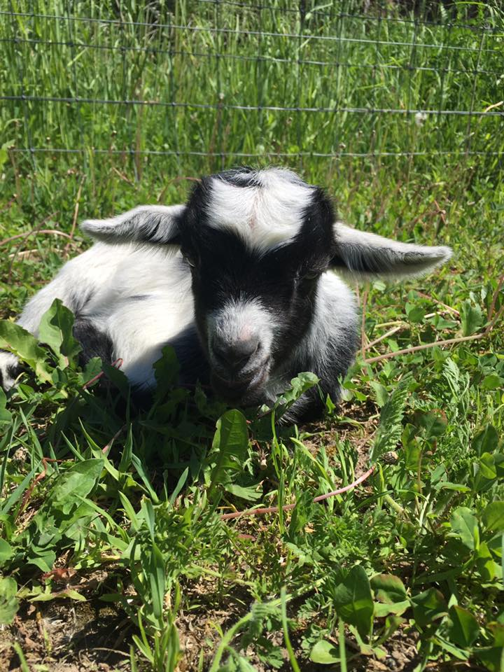


First and foremost…

Slide 2

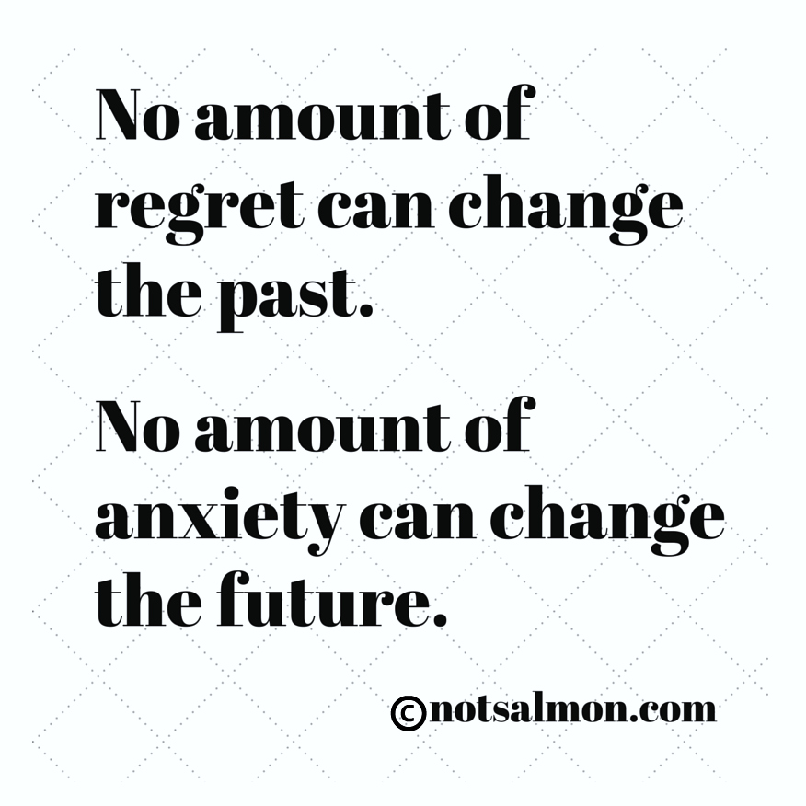

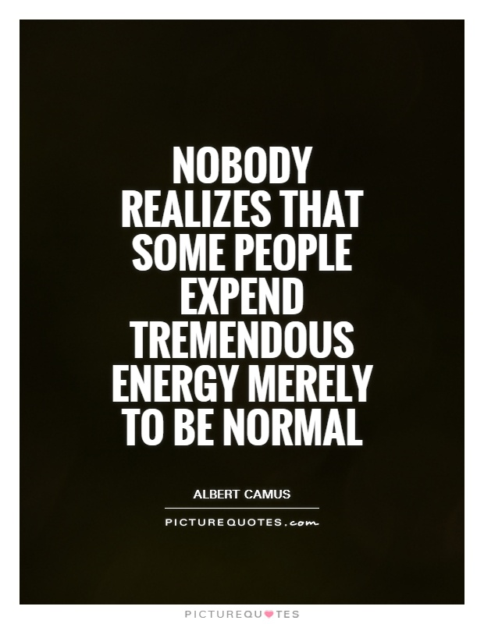
Removing the stigma

Slide 3
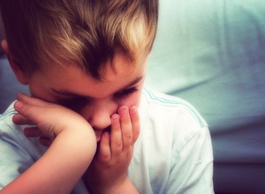
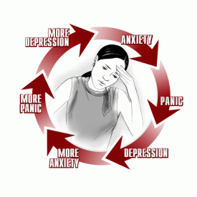
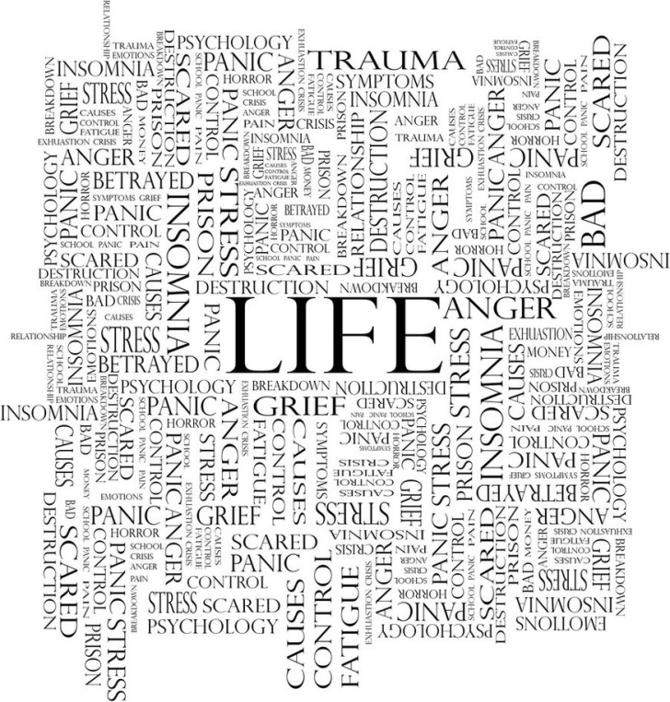
Anxiety Disorders
What does anxiety look like?

Slide 4
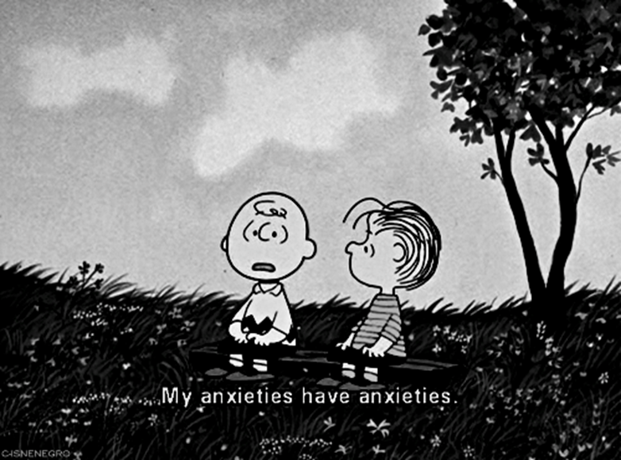

Slide 5
Activity
https://answergarden.ch/644030
https://answergarden.ch/644033

Slide 7
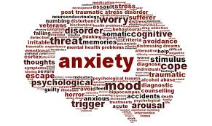
Anxiety Disorders
-Approxiamtely17% of people will suffer from an anxiety disorder at some point in their lives-this number is rising
-That a panic attack can feel as though one is having a heart attack, even though there is nothing wrong with their heart. (other than elevation in HR due to stress)
-We are genetically predisposed to acquiring a fear of snakes, as opposed to cuddly animals?
-Anxiety and Fear are normal responses,

Slide 8
Anxiety is a base disorder
https://www.youtube.com/watch?v=vnKZ4pdSU-s
http://psychcentral.com/news/2010/06/21/anxiety-panic-prevalent-among-tourette-syndrome-sufferers/14812.html
https://www.youtube.com/watch?v=HPmpIY7XJVE

Slide 9
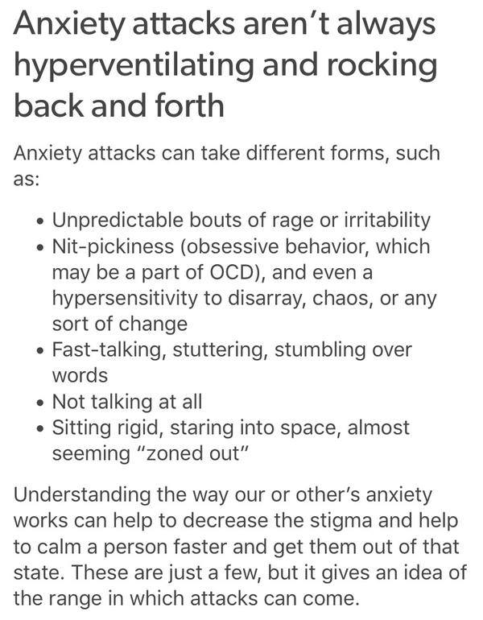

Anxiety isn’t always to recognize

Slide 10
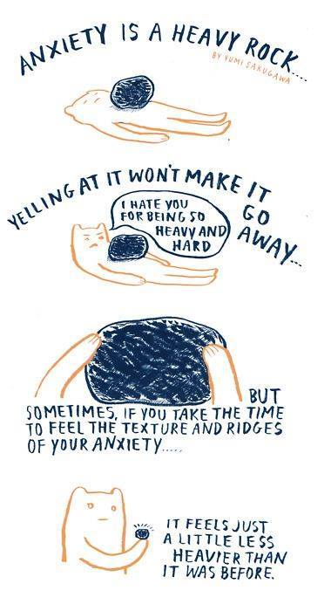

It isn’t always to shake it off

Slide 11
Anxiety, Fear, and Panic
Anxiety is a “state of Apprehension”
There is much in our world we have to be anxious about-health, relationships, careers, state of the environment, ect.
It is an emotional, psychological state, characterized by physiological arousal, an unpleasant feeling of tension and a sense of apprehension or dread about something in the future.
How can anxiety sometimes be helpful? –next slide

Slide 12
Normal anxiety
It is normal to experience a certain amount of apprehension about future danger or misfortune.
Examples? *Eustress
Notes:
Health, social relationships, exams, jobs, money,…..

Slide 13
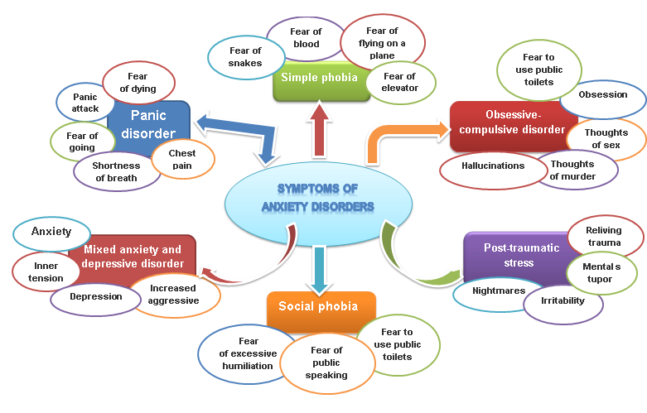
Types of Anxiety Disorders

Slide 14
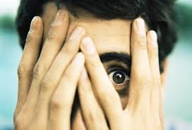
Anxiety, Fear, and Panic
Fear
Unpleasant emotion caused by the belief that someone or something is going to be dangerous, cause pain, or a threat of any kind.
Immediate fight or flight response to danger or threat (whether it is real or imagined.)
Strong avoidance/escapist tendencies
Involves abrupt activation of the sympathetic nervous system- the part of our CNS that prepares us for the threat of emergency.

Slide 15
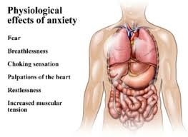
Psychological and Physiological

Slide 16
From Normal to Disordered Anxiety and Fear
Characteristics of Anxiety Disorders:
Psychological disorders – Pervasive and persistent symptoms of anxiety and fear
Involve excessive avoidance and escapist tendencies, symptoms can cause significant distress.
http://www.youtube.com/watch?v=BXHxg6Ug9GM
Features of Anxiety chart- pg 100

Slide 17
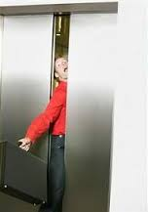


Panic as An Anxiety Disorder

Slide 18
Panic Attacks
What Is a Panic Attack?
Abrupt experience of intense fear or discomfort
Accompanied by several physical symptoms (e.g., breathlessness, chest pain)
Panic Disorder is the occurrence of repeated, unexpected panic attacks. They are intense anxiety reactions accompanied by shortness of breath, difficulty breathing, heavy perspiration, weakness and dizziness, accompanied by feelings of terror, helplessness and a strong desire to escape.
Have to have repeat episodes for it to be a diagnosed disorder.
Can be associated with agoraphobia, or other phobias such as specific, social, OCD, PTSD,
Notes:
Agoraphobia is a fear of places and situations where it may be difficult to escape in the event of a panic attack-ex. Crowds, bridges, methods of travel, restaurants, or just leaving the house.

Slide 19
Diagnostic Features of Panic Attacks
Heart palpitations
Sweating
Trembling
Shortness of breath or being smothered sensation
Chest pains
Nausea
Fear of losing control

Slide 20

Phobias
https://www.youtube.com/watch?v=Xge49FuX5v4

Slide 21
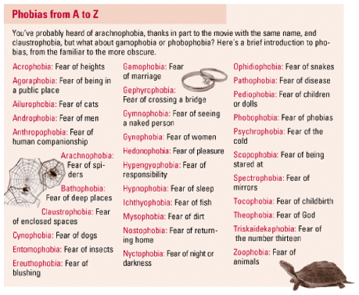

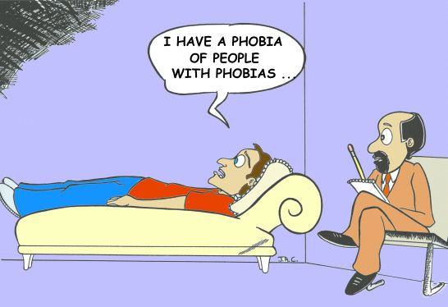
Specific Phobias

Slide 22
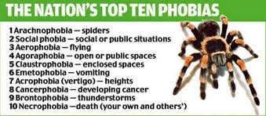
Types of Phobias
Agoraphobia
http://www.youtube.com/watch?v=BL2RP0Ojgnw&feature=related
http://www.fearof.net/top-10-phobias-of-all-time/

Slide 23
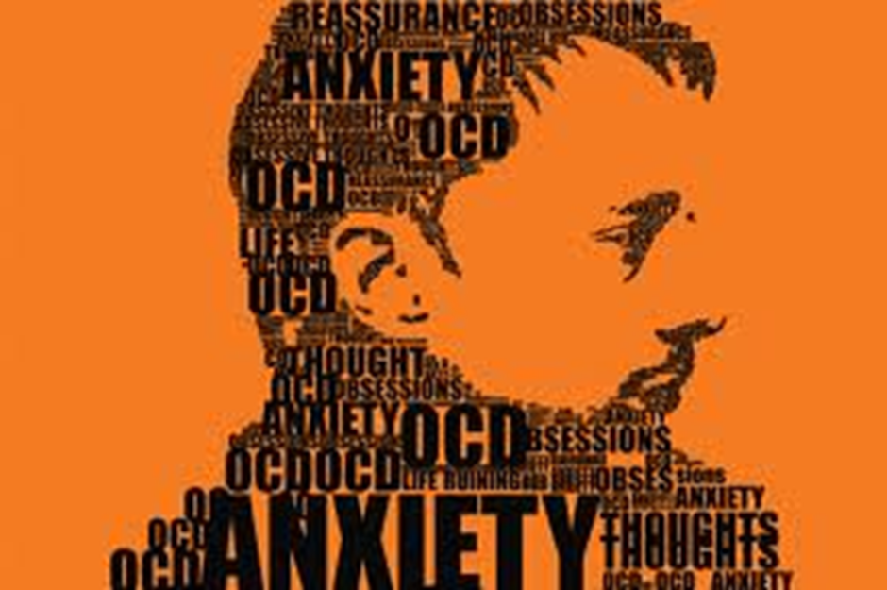
OCD

Slide 24
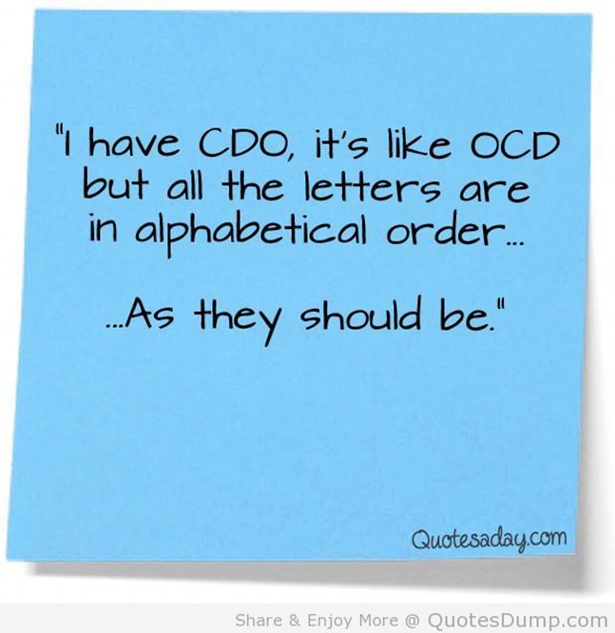
Obsessive Compulsive Disorder
http://www.youtube.com/watch?v=dSZNnz9SM4g

Slide 25
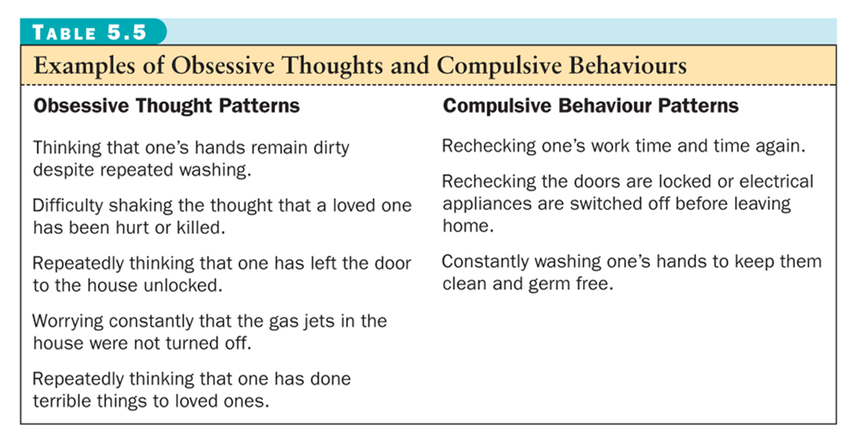
OCD

Slide 26
Trauma and Stressor-related disorders
Newer chapter in DSM 5
Adjustment Disorders-among the mildest of the disorders
Within a few months of the onset of the stressor
Significant impairment in social, occupational, or academic functioning
Exceeding emotional distress
Must not meet Dx of other clinical syndromes
May resolve, cope or if reaches 6 months may be diagnosed as another disorder

Slide 27

Post – Traumatic Stress disorder (PTSD)
Individuals who are exposed to traumatic experiences are at a higher risk for PTSD as well as major depression, panic disorder, general anxiety disorders, and potential substance abuse.
PTSD Is an anxiety disorder found in people who have been through extremely traumatic events. A traumatic event can be defined as an event that has a capacity to provoke fear, helplessness, or horror in response to the threat of injury or death.

Slide 28

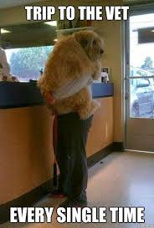
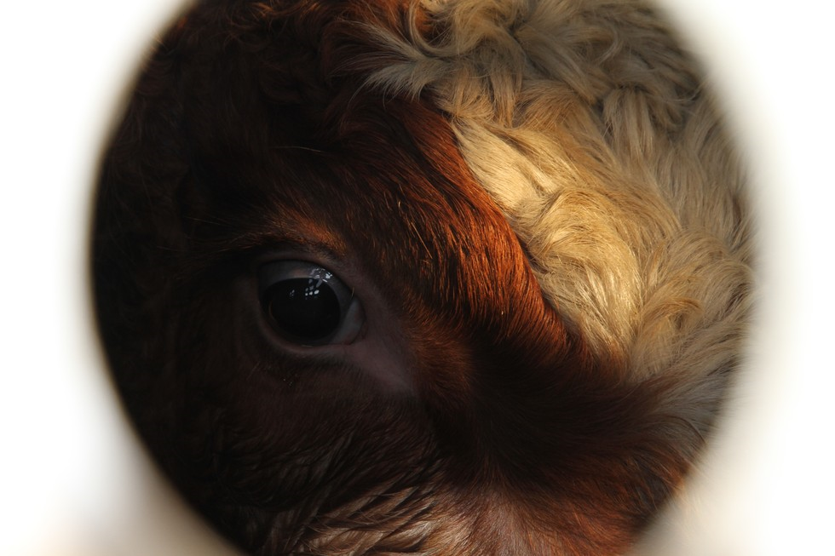
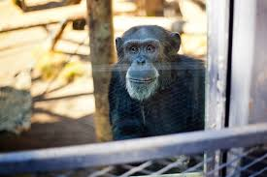
Animals experience it too

Slide 29
Acute & Posttraumatic Stress Disorder
Acute Stress Disorder (ASD): A traumatic stress reaction occurring in the days and weeks following exposure to a traumatic event.
Posttraumatic Stress Disorder (PTSD): A prolonged reaction to a traumatic event that threatened death or serious injury to one’s own or another’s physical safety.
Features of Traumatic Stress Reactions
Extreme anxiety or dissociation (feelings of detachment from one’s self or one’s environment)
Intrusive memories & flashbacks
Heightened arousal or vigilance
Difficulty concentrating

Slide 30
Biological Contributions to Anxiety and Panic
Diathesis-Stress
Inherit vulnerabilities for anxiety and panic, not anxiety disorders
Stress and life circumstances activate the underlying vulnerability
Genetic Predisposition to Anxiety Disorders (multiple disorders) influence probability
Biological Causes and Inherent Vulnerabilities
Neurotransmitters-GABA- an inhibitory neurotransmitter in our brain that is believed to play a role in anxiety. It is meant to tone down stressful activity in the brain. When this substance is inadequate neurons in our brain can fire excessively causing states of anxiety.
Hyperventilation can cause excess amounts of oxygen leaving us feeling faint or light headed.

Slide 31
Psychological Contributions
Began with Freud-Psychodynamic
Anxiety is a psychological reaction to danger and they reflect energies attached to unconscious conflicts. (ex. Our natural threatening impulses are surfacing)

Slide 32
Behaviourism
Behaviouristic Views
Anxiety and fear result from direct classical and operant conditioning and modeling. It argues that a neutral object or situation gains the capacity of being fearful when connected to aversive stimuli.
For example a child who fears the loud bark of one certain dog, may learn to fear all dogs in general.
PTSD can involve neutral (but conditioned)stimuli such as the sights, sounds, smells associated with the trauma scene to evoke the anxiety over and over.
Some challenges with this view is that the phobia developed early in childhood and the person can not remember why he or she fears for example, a dog.

Slide 33
Cognitive Perspectives
Self defeating or irrational thoughts can heighten and perpetuate anxiety disorders. ** easier said than done to avoid these thoughts.
A person can exaggerate the situation and their ability to cope with or escape from it, and convince themselves that there is nothing they can do, and they can begin to lose control.
Normal obsessions are part of the cognitive model.

Slide 34
Psychosocial Contributions
Social Contributions
Stressful life events as triggers of biological/psychological vulnerabilities
Many stressors are familial and interpersonal

Slide 35
Toward an Integrated Model
Integrative View
Biological vulnerability interacts with psychological, experiential, and social variables to produce an anxiety disorder
Consistent with diathesis-stress model

Slide 36
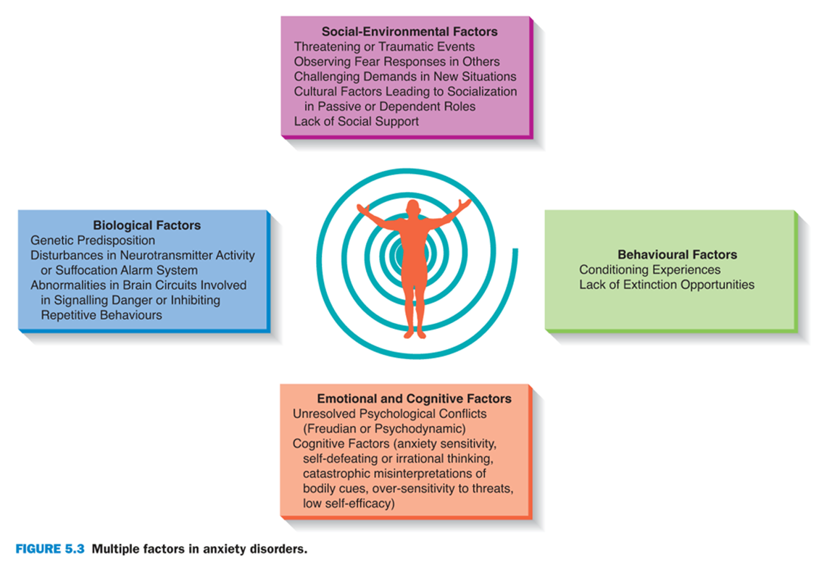
Tying it all together

Slide 37
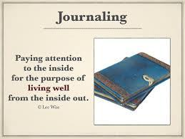
Treatment
Psychodynamic approach is do deal with inner conflicts so the mind can focus on more positive and self enhancing tasks.
Humanistic approach believes that our anxieties develop from social repression of our genuine selves, and aims at helping people get in touch with our genuine talents and feelings.

Slide 38
Treatments cont’d
Biological Approach-A variety of drugs are used to treat disorders, that have a calming effect.
Addiction is a negative side-effect, which can lead to other stressful symptoms of withdrawal.
Anti-depressant drugs are used to treat phobias.
Learning Based Approach-Systematic desensitization, gradual exposure.

Slide 39
Treatment
Cognitive-behaviour therapies are highly effective with the goal of replacing irrational thoughts with rational ones.
Best long-term outcome is with cognitive-behaviour therapy alone-referred to s cognitive restructuring.
Chart in text

Slide 40
Facts….
Not all people who experience traumatic events develop related phobias or anxiety reactions.
Some people may inherit a genetic predisposition (diathesis) that makes them respond with greater negative arousal or makes them more likely to panic in response to changes in bodily sensations.
Whether anxiety gets out of control may depend on another vulnerability factor, anxiety sensitivity.

